Slide 1
Lesson 1 Phi Sigma Rho Pride
Objectives
To demonstrate the history and spirit of Phi Sigma Rho, to generate excitement among new members, and to share expectations for new members as individuals

Slide 2
Membership Education
Reasons for membership education
To develop an appreciation for Phi Sigma Rho by learning its history, heritage, ideals, programs, and traditions
To prepare each woman for initiation and her obligations as a sister
To learn about the social Greek System and explore its values and benefits
To provide a candidate for membership the opportunity to better understand the sisters of the chapter by experiencing sorority activities, developing friendships and feeling the bonds of sisterhood before obligating herself to a lifelong commitment
To further evaluate each woman’s merits before initiation and to give the candidate for membership time to evaluate the chapter and assess her own desire for initiation

Slide 3
Status
Candidate
A woman who accepts a formal invitation from the chapter and begins to learn about Phi Sigma Rho
May also be described as associate or new member
Active
An initiated undergraduate member
Affiliate
A member of Phi Sigma Rho who transfers to another university where there is an active chapter can “affiliate” with that chapter as long as she was in good standing when she left her former chapter
Alumna
A member of Phi Sigma Rho who is no longer attending the college of the chapter which initiated her

Slide 4
History
Founders are Rashmi Khanna (ChemE) and Abby McDonald (EE)
Abby McDonald participated in formal rush prior to founding Phi Sigma Rho
Purdue, September 24, 1984
The purpose of founding Phi Sigma Rho was to offer women engineers a new alternative to the existing sororities – an alternative that would provide the atmosphere of a social sorority, yet consider the demands placed upon engineering students.

Slide 5
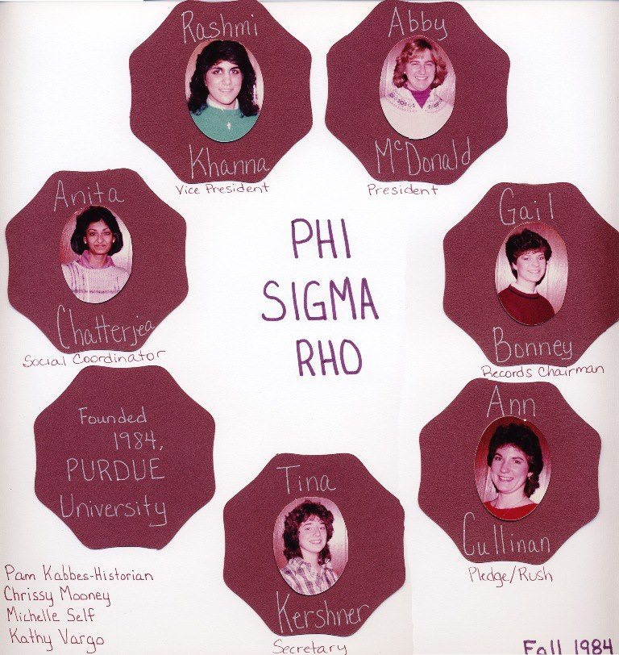
History
Ten charter class members
Rashmi (Khanna) Drummond
Abby (McDonald) Schwartz
Gail Bonney
Anita Chatterjea
Ann Cullinan
Christine (Mooney) Jackson
Pam Kabbes
Tina Kershner
Michelle Self
Kathy Vargo

Slide 6
Creed
Created by the Gamma class at Purdue
Recited during inductions and before every meeting
Focuses on our values:
Friendship
Scholarship
Encouragement

Slide 7
Insignia
Colors - Wine Red and Silver
Jewel – Pearl
Flower – Orchid
Mascot – Sigmand Penguin
Animal – Penguin
Nickname – Phi Rho

Slide 8
Insignia
Motto - Together we build the future
Logo -

Slide 9
Insignia
Coat of Arms
Silver shield containing a pearl and the year of installation at the base
Center contains a silver star over a gold key enclosed within a wine red circle from which a gold sun is rising
Top contains alternating sections of wine red and silver above which is a gold pyramid
Public motto is above the shield in Greek
Name of Phi Sigma Rho is below the shield

Slide 10
Insignia
Badge
Consists of a pyramid, with a star over a key on the front and ten squares on the one visible side
Enclosed within a wine red circle containing the Greek letters from which a sun is rising
May be cast in silver or gold
Only initiated members may wear or use the badge, or any other insignia or item bearing the Pyramid, the Star, the Coat of Arms, or Greek letters

Slide 11
Pearl Pin
Worn every first Monday (Wednesday) of every month during member education period
Appropriate attire is formal/business casual wear
Placed on the left, over the heart
Worn by candidates - initiated members wear the badge and Greek letters
Symbolizes commitment to the sisterhood
Appropriate
Inappropriate

Slide 12
Qualities of Sisterhood
Each woman admitted to membership in Phi Sigma Rho is believed to be:
A woman of good character
With friendly personality and encouraging disposition
A student of scholarship
With the ingenuity, ambition, inner strength and endurance to meet life’s challenges
An individual possessed of optimism and respect for diversity
Having a deep sense of personal responsibility, integrity and loyalty

Slide 13
Spirit of Phi Sigma Rho
The spirit of Phi Sigma Rho is
To look for a brighter side and look forward to tomorrow
To be flexible in our attitudes and to become well rounded individuals
To pull our own weight and help each other unselfishly
To firmly adhere to our own values and believe them with all our heart
To stand by each one of our sisters during bad times as well as good
Is what it means to be a Sister of Phi Sigma Rho

Slide 14
Spirit of Phi Sigma Rho
The spirit of Phi Sigma Rho is
To have the ability to view new perspectives, and focus them into being
To seek goals and be willing to take a risk
To have inner strength to overcome the obstacles that we face, and remain firm in our beliefs
To have the endurance to carry on, and leave something behind for the future
Is what enables the Sisterhood of Phi Sigma Rho to pass the test of time

Slide 15
Mission
Phi Sigma Rho is a social sorority for women in technical studies serving our sisters and the community by promoting:
High standards of personal integrity, respect, and character,
Lifelong bonds of sisterhood, and
Academic and professional excellence with a social balance
Through shared experiences, common bonds, and recognition of service and achievement.

Slide 16
Vision
Be the foremost sorority for women in technical studies.

Slide 17
Objectives
To foster and provide the broadening experience of sorority living with its social and moral challenges and responsibilities for the individual and the chapter
To develop the highest standard of personal integrity and character
To promote academic excellence and support personal achievement, while providing a social balance
To aid the individual in the transition from academic to the professional community
To maintain sorority involvement with the alma mater and the community through responsible participation
To maintain the bond of sisterhood with alumnae members through communication, consultation, and participation in Sorority functions

Slide 18
Expectations
Learn about the history of Phi Sigma Rho, the social Greek system, the national organization of Phi Sigma Rho, and responsibilities of an active member of a chapter
Complete knowledge assessment each week covering material from previous meetings
All information is found within the member manual and Constitution, Bylaws, and Policies

Slide 19
Expectations
Membership Education Book
Point system and requirements
Calendar of events
Secrecy is required

Slide 20
Next Week
Knowledge Assessment
Creed
See page 11 of the Member Manual
Phi Sigma Rho history and symbols

